Slide 1
DBMS PROJECT
TEAM MEMBERS:
THOPARAM ADITHYA VARDHAN-21CSB0B60
ELAGONDA VIVEK-21CSB0B15

Slide 2
CONTENTS:
PROBLEM STATEMENT
ER DIAGRAM
NORMALISATION
RELATIONS
RELATIONAL SCHEMA
TABLES CREATION
TABLES DISPLAY
SQL QUERIES

Slide 3
PROBLEM STATEMENT:
This database that we have constructed in our project basically gives a broad overview about how a food manufacturing company works, in general there are many companies in this business, we have analysed how the data is managed in those companies and have constructed an efficient DB.
This database consists of only essential components (entities) that covers almost all features of a efficient food manufacturing Company ,giving an edge to
to have data of the distributors of the company who are distributing products.
the ingredients used in the process of manufacturing.
different types of products produced by the company.
the types of employees working in the company and their working hours.

Slide 4
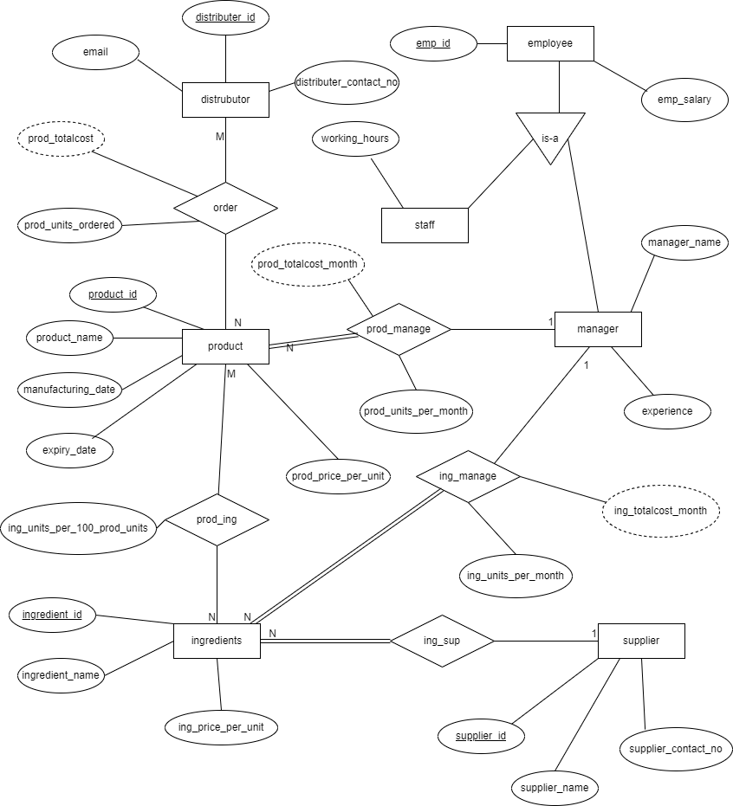
ER DIAGRAM:

Slide 5
RELATIONS:
S.NO | ENTITY1 | ENTITY2 | RELATIONSHIP NAME | RELATION | EXPLANATION
1. | supplier | Ingredients | Ing_sup | One-to-many | A supplier may supply multiple products but an ingredient is supplied by a single supplier
2. | Ingredients | Products | Prod_ing | Many-to-many | An ingredient may used in making multiple products and a products require multiple ingredients to make
3. | Product | Distributer | Order | Many-to-many | A distributer may order multiple products and a product may be ordered by multiple distributers
4. | Ingredients | Manager | Ing_manage | Many-to-one | Multiple ingredients are managed by a single manager but a product is managed by single manager
5. | Product | Manager | Prod_manage | Many-to-one | Multiple products managed by a single manager but a product is manged by single manager

Slide 6
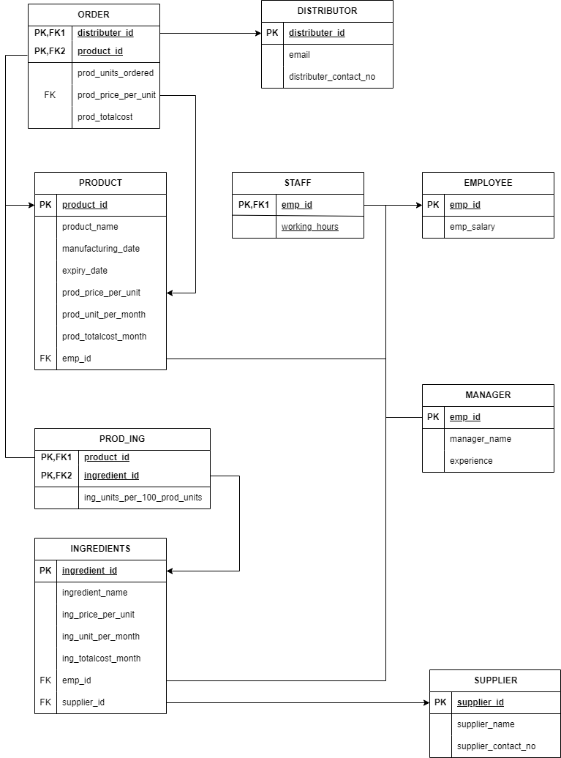
RELATIONAL SCHEMA:

Slide 7
ASSUMPTIONS:-
A particular ingredient is supplied by only one supplier but a supplier may supply more than one ingredients.
Only two types of workers are present one type of them are managers and other are general workers.
All the products manufactured and ingredients bought are under the supervision of the mangers.
A distributor may order more than one product and also a product may be ordered by more than one distributor.

Slide 8
SUPPLIER:- The table supplier contains the data of suppliers who supplies ingredients to the manufacturing company. Attributes: Supplier_id Supplier_name Supplier_contact_no Primary key: supplier_id EMPLOYEE: The table of employee contains the data of employees who works for the company. Attributes: Emp_id Emp_salary Primary Key: emp_id

Slide 9
STAFF: Staff contains the information of the employees who are not managers, we have the data of working hours of the staff. Attributes: Emp_id Working hours Primary key: emp_id Foreign keys: emp_id references employee(emp_id) MANAGER: The table Manager contains data of the managers i.e., their names and their experience as managers in the company. Attributes: Emp_id Manager_name Experience Primary key: emp_id Foreign key: emp_id references employee(emp_id)

Slide 10
PRODUCT: The table product has the data of products manufactured. Attributes: Product_ID Product_name Manufacturing_data Expiry_date Prod_price_per_unit Prod_unit_per_month Prod_totalcost_month Emp_id Primary key: product_id Foreign key: emp_id references employee(emp_id)

Slide 11
INGREDIENTS: The table ingredients contains the data of ingredients, supplier’s who supplies a particular ingredient employee associated with the ingredient etc. Attributes: Ingredient_id Ingredient_name Ing_price_per_unit Ing_units_per_month Ing_totalcost_month Emp_id Supplier_id Primary key: ingredient_id Foreign key: emp_id references employee(emp_id) Supplier_id references supplier(supplier_id)

Slide 12
PROD_ING: This table consists the data of products and ingredients together and the data of number of ingredient units required to manufacture 100 ingredients of a product. Attributes: Product_id Ingredient_id Ing_units_per_100_prod_units Primary key: product_id,ingredient_id Foreign key: ingredient_id references ingredients(ingredient_id) DISTRIBUTOR: This table has the data of distributors who distribute the products into the market. Attributes: Distributor_id Email Distributor_contact_no Primary key: distributor_id

Slide 13
ORDER: The table order has the data of orders placed by the distributors. Attributes: Distributor_id Product_id Prod_units_ordered Prod_totalcost Primary key: distributor_id, product_id Foreign key: distributor_id references distributor(distributor_id) Product_id references product(product_id)

Slide 14
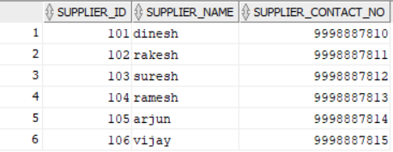
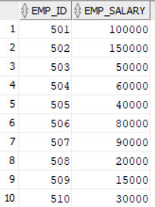
TABLES: Supplier: Employee:

Slide 15
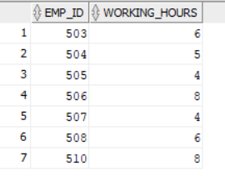
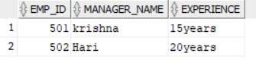
Staff: Manager:

Slide 16
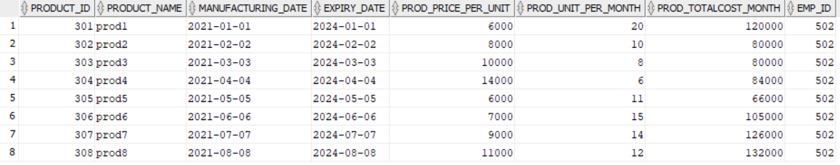
Products:

Slide 17
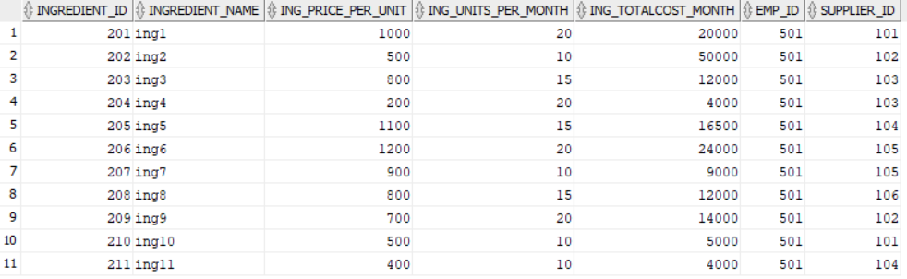
Ingredients:

Slide 18
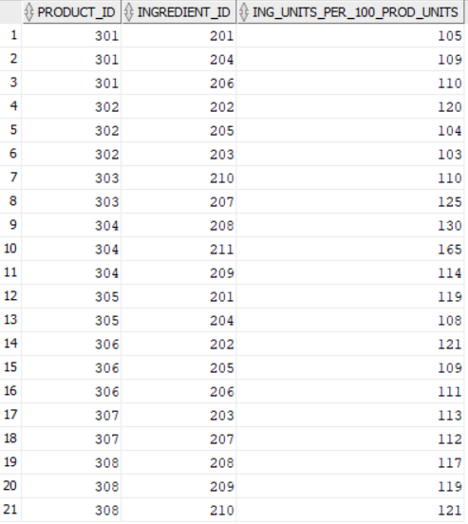
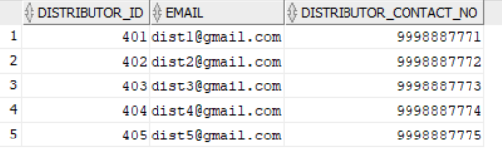
Prod_ing: distributor:

Slide 19
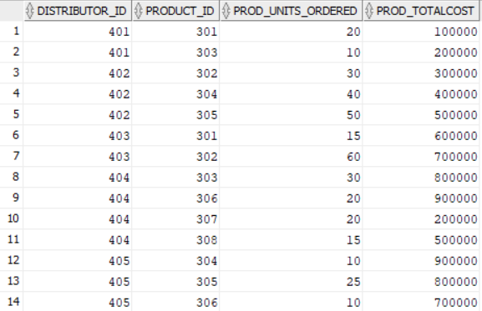
Order:

Slide 20
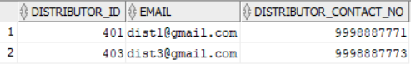
Queries: 1)Write a SQL query to display email and contact number of distributor who ordered product with product_id=301? Query: Select distributor_id,email, distributor_contact_no from order1 natural join distributor where product_id=301;

Slide 21
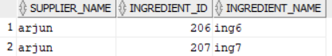
2) Write an SQL query to display ingredients supplied by supplier ‘arjun’. Query: Select supplier_name,ingredient_id,ingredient_name from ingredients natural join supplier where supplier_name= ‘arjun’;

Slide 22
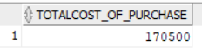
3)Write an SQL query to display the total amount the company spends in buying ingredients. Query: Select sum(ing_totalcost_month) as totalcost_of_purchase from ingredients;

Slide 23
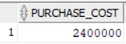
4)Write an SQL query to display the cost of purchase of goods by distributor with id number 404. Query: Select sum(prod_totalcost) as purchase_cost from order where distributor_id=404;

Slide 24
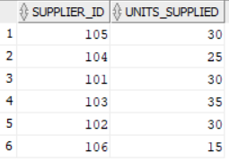
5)Write an SQL query to display total units of ingredients supplied by each supplier. Query: Select supplier_id,sum(ing_units_per_month) as units_supplied from ingredients natural join supplier group by supplier_id;

Slide 25
THANK YOU

